Slide 1
L14. Markov Decision Process
(Dynamic Programming Approach)

Slide 2
L14. Markov Decision Process
(Dynamic Programming Approach)
Policy Evaluation
Policy Improvement
Policy iteration
Value Iteration

Slide 3

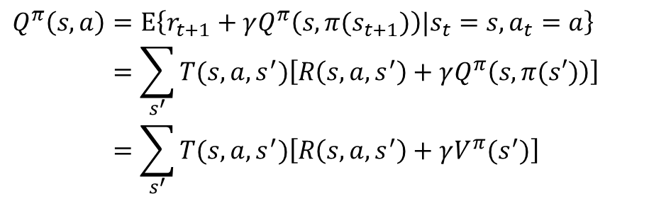
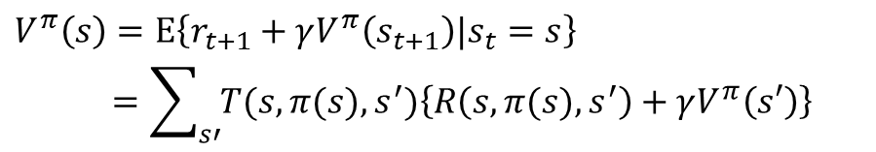

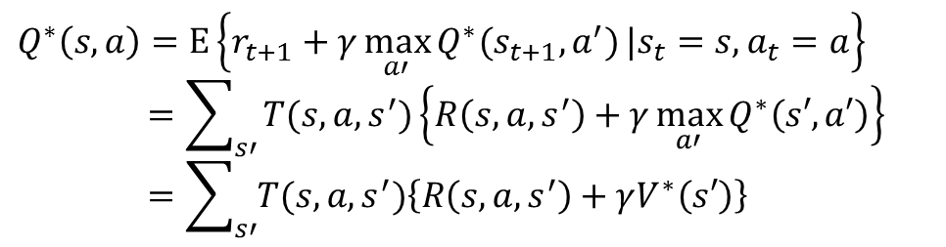
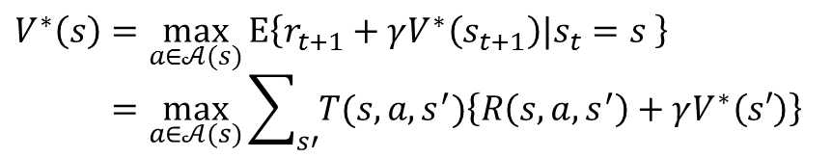
Summary
$$V^{π}\left(s\right)=E\left\{r_{t+1}+γV^{π}\left(s_{t+1}\right)|s_{t}=s\right\}$$
$$=\sum_{s′}{T(s,π(s),s^{′})\left\{R\left(s,π(s),s^{′}\right)+γV^{π}\left(s′\right)\right\}}$$
$$Q_{ }^{π}\left(s,a\right)=E\left\{r_{t+1}+γQ_{ }^{π}\left(s,π(s_{t+1})\right)|s_{t}=s,a_{t}=a\right\}$$
$$=\sum_{s^{′}}{T(s,a,s^{′})\left[R\left(s,a,s^{′}\right)+γQ_{ }^{π}\left(s,π(s′)\right)\right]}$$
$$=\sum_{s^{′}}{T(s,a,s^{′})\left[R\left(s,a,s^{′}\right)+γV^{π}(s^{′})\right]}$$
$$V^{π}\left(s\right)=Q_{ }^{π}\left(s,π(s)\right)$$
$$V^{∗}\left(s\right)=\max_{a∈𝒜(s)}{E\left\{r_{t+1}+γV^{∗}\left(s_{t+1}\right)|s_{t}=s \right\}}$$
$$=\max_{a∈𝒜(s)}{\sum_{s′}{T(s,a,s^{′})\left\{R\left(s,a,s^{′}\right)+γV^{∗}\left(s′\right)\right\}}}$$
$$Q^{∗}\left(s,a\right)=E\left\{r_{t+1}+γ\max_{a′}{Q^{∗}(s_{t+1},a^{′})}|s_{t}=s,a_{t}=a\right\}$$
$$=\sum_{s′}{T(s,a,s^{′})\left\{R\left(s,a,s^{′}\right)+γ\max_{a′}{Q^{∗}\left(s′,a′\right)}\right\}}$$
$$=\sum_{s′}{T(s,a,s^{′})\left\{R\left(s,a,s^{′}\right)+γV^{∗}\left(s′\right)\right\}}$$
$${∵V}^{∗}\left(s′\right)=\max_{a′}{Q^{∗}\left(s′,a′\right)}$$

Slide 4



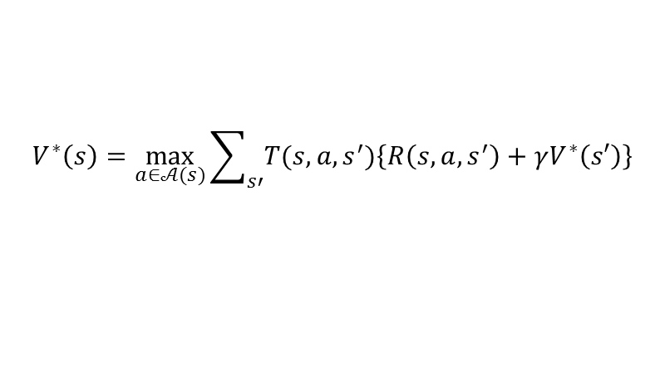



















Summary
Bellman optimality equation for $V^{∗}(s)$
$$Q^{∗}(s,a_{1})$$
$$s_{1}$$
$$V^{∗}(s^{′}=s_{1})$$
$$s,a_{1}$$
$$a_{1}$$
$$s_{2}$$
$$V^{∗}(s^{′}=s_{1})$$
$$Q^{∗}(s,a_{2})$$
$$s_{1}$$
$$s$$
max
$$a_{2}$$
$$s,a_{2}$$
$$V^{∗}(s)$$
$$s_{2}$$
$$a_{3}$$
$$Q^{∗}(s,a_{3})$$
$$s_{1}$$
$$s,a_{3}$$
$$s_{2}$$
$$V^{∗}\left(s\right)=\max_{a∈𝒜(s)}{\sum_{s′}{T(s,a,s^{′})\left\{R\left(s,a,s^{′}\right)+γV^{∗}\left(s′\right)\right\}}}$$
$${∵V}^{∗}\left(s\right)=\max_{a′}{Q^{∗}\left(s,a′\right)}$$

Slide 5


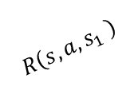

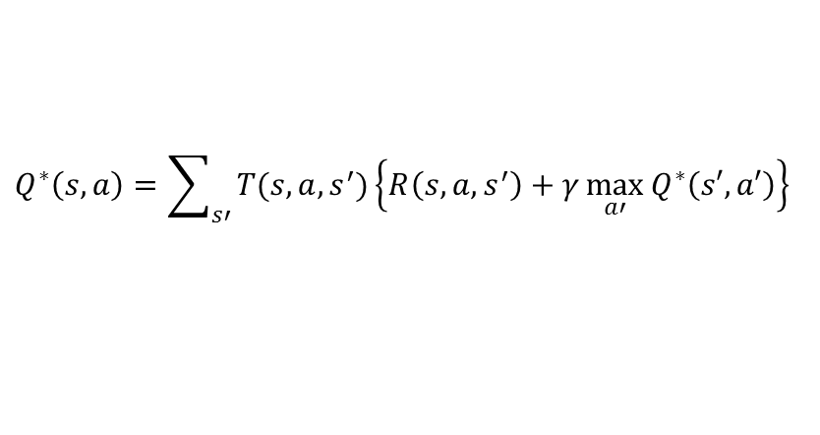


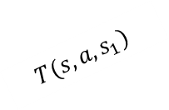


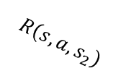
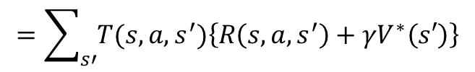








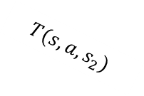






Summary
Bellman optimality equation for $Q^{∗}(s,a)$
$$S^{′}$$
$$A^{′}$$
$$a_{1}$$
$$s_{1},a′$$
$$Q^{∗}\left(s_{1},a′\right)$$
$$s_{1}$$
max
$$T(s,a,s_{1})$$
$$a_{2}$$
$$s_{1},a′′$$
$$R\left(s,a,s_{1} \right)$$
$$Q^{∗}\left(s_{2},a′′\right)$$
$$Q^{∗}(s,a)$$
$$s,a$$
$$T(s,a,s_{2})$$
$$a_{1}$$
$$s_{2},a′$$
$$Q^{∗}\left(s_{1},a′\right)$$
$$R\left(s,a,s_{2}\right)$$
$$s_{2}$$
max
$$a_{2}$$
$$s_{2},a′′$$
$$Q^{∗}\left(s_{2},a′′\right)$$
$$Q^{∗}\left(s,a\right)=\sum_{s′}{T(s,a,s^{′})\left\{R\left(s,a,s^{′}\right)+γ\max_{a′}{Q^{∗}\left(s′,a′\right)}\right\}}$$
$$=\sum_{s′}{T(s,a,s^{′})\left\{R\left(s,a,s^{′}\right)+γV^{∗}\left(s′\right)\right\}}$$
$${∵V}^{∗}\left(s′\right)=\max_{a′}{Q^{∗}\left(s′,a′\right)}$$

Slide 6
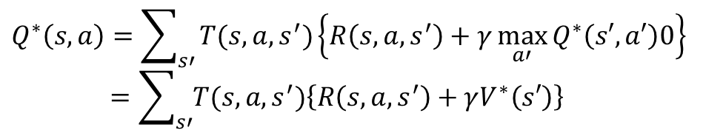

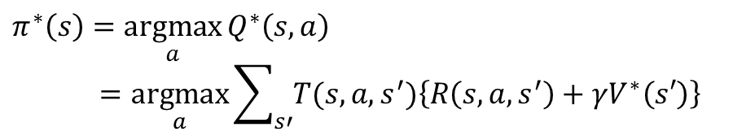

Dynamic Programming
The term dynamic programming (DP) refers to a collection of algorithms that can be used to compute optimal polices given a perfect model of the environment as a Markov decision process (MDP)
The key idea of DP (and reinforcement learning) is the use of value functions to organize and structure the search for good policies
Optimal policies can be derived from the optimal value functions that satisfy the Bellman optimality equations
$$V^{∗}\left(s\right)=\max_{a∈𝒜(s)}{\sum_{s′}{T(s,a,s^{′})\left\{R\left(s,a,s^{′}\right)+γV^{∗}\left(s′\right)\right\}}}$$
$$Q^{∗}\left(s,a\right)=\sum_{s′}{T(s,a,s^{′})\left\{R\left(s,a,s^{′}\right)+γ\max_{a′}{Q^{∗}\left(s′,a′\right)0}\right\}}$$
$$=\sum_{s′}{T(s,a,s^{′})\left\{R\left(s,a,s^{′}\right)+γV^{∗}\left(s′\right)\right\}}$$
$${∵V}^{∗}\left(s′\right)=\max_{a′}{Q^{∗}\left(s′,a′\right)}$$
Optimal policy
$$π^{∗}\left(s\right)=\underset{a}{argmax}{Q^{∗}\left(s,a\right)}$$
$$=\underset{a}{argmax}{\sum_{s′}{T(s,a,s^{′})\left\{R\left(s,a,s^{′}\right)+γV^{∗}\left(s′\right)\right\}}}$$

Slide 7
Robot example
Recycling Robot Example
Systems of equations for the optimum Bellman function

Slide 8

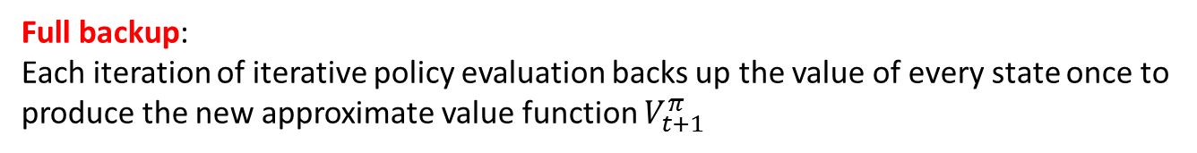
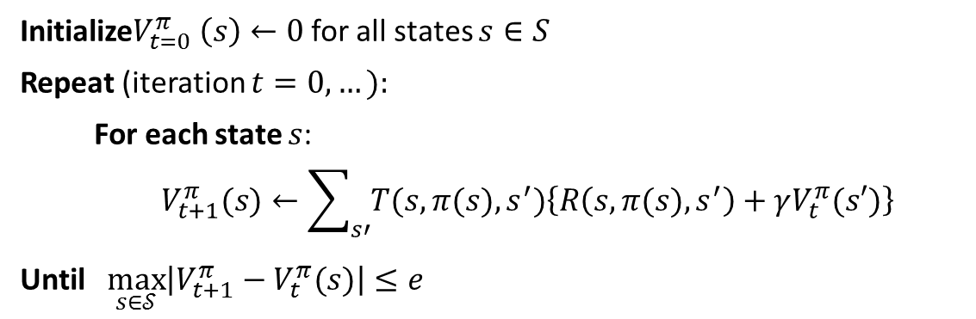
Policy Evaluation
Policy evaluation :
A method to compute the state-value function $V^{π}(s)$ for an arbitrary policy $π:𝒮→𝒜$
$$V^{π}(s)=\sum_{s′}{T(s,π(s),s^{′})\left\{R\left(s,π(s),s^{′}\right)+γV^{π}(s′)\right\}}$$
A system of $\left|𝒮\right|$ simultaneous linear equations in $\left|𝒮\right|$ unknown
Algorithm
Initialize$V_{t=0}^{π} \left(s\right)←0$ for all states $s∈S$
Repeat (iteration $t=0,…):$
For each state $s$:
$$V_{t+1}^{π}(s)←\sum_{s′}{T(s,π(s),s^{′})\left\{R\left(s,π(s),s^{′}\right)+γV_{t}^{π}(s′)\right\}}$$
Until $\max_{s∈𝒮}\left|V_{t+1}^{π}−V_{t}^{π}(s)\right|≤e$
Full backup:
Each iteration of iterative policy evaluation backs up the value of every state once to produce the new approximate value function $V_{t+1}^{π}$

Slide 9

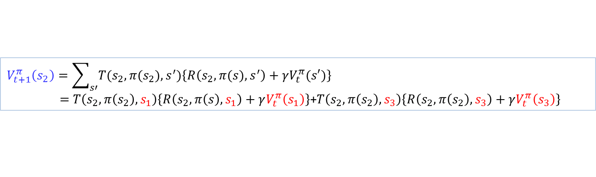





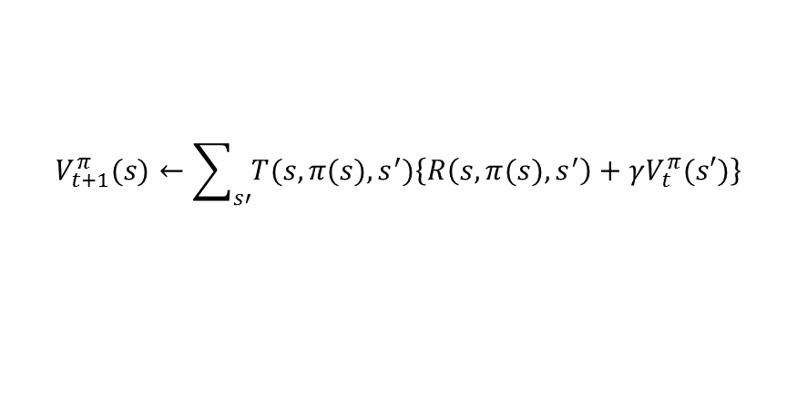









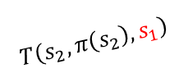







Policy Evaluation
$$V_{t+1}^{π}(s)←\sum_{s′}{T(s,π(s),s^{′})\left\{R\left(s,π(s),s^{′}\right)+γV_{t}^{π}(s′)\right\}}$$
Example:
$$V_{t+1}^{π}\left(s_{2}\right)=\sum_{s′}{T(s_{2},π(s_{2}),s^{′})\left\{R\left(s_{2},π(s),s^{′}\right)+γV_{t}^{π}(s′)\right\}}$$
$=T\left(s_{2},π\left(s_{2}\right),s_{1}\right)\left\{R\left(s_{2},π\left(s\right),s_{1}\right)+γV_{t}^{π}\left(s_{1}\right)\right\}$+$T\left(s_{2},π\left(s_{2}\right),s_{3}\right)\left\{R\left(s_{2},π\left(s_{2}\right),s_{3}\right)+γV_{t}^{π}\left(s_{3}\right)\right\}$
“Two-arrays” update
“In place” update
$$V_{t+1}^{π}\left(s\right)$$
$$V_{t}^{π}\left(s\right)$$
$$V_{t+1}^{π}\left(s\right)$$
$$s_{1}$$
$$T\left(s_{2},π\left(s_{2}\right),s_{1}\right)$$
$$s_{1}$$
$$s_{1}$$
$$T\left(s_{2},π\left(s_{2}\right),s_{1}\right)$$
$$R\left(s_{2},π\left(s_{2}\right),s_{1}\right)$$
$$R\left(s_{2},π\left(s_{2}\right),s_{1}\right)$$
$$s_{2}$$
$$s_{2}$$
$$s_{2}$$
$$s_{3}$$
$$T\left(s_{2},π\left(s_{2}\right),s_{3}\right)$$
$$s_{3}$$
$$s_{3}$$
$$T\left(s_{2},π\left(s_{2}\right),s_{3}\right)$$
$$R\left(s_{2},π\left(s_{2}\right),s_{3}\right)$$
$$R\left(s_{2},π\left(s_{2}\right),s_{3}\right)$$
$$s_{N}$$
$$s_{N}$$
$$s_{N}$$
Usually faster!
Less memory

Slide 10


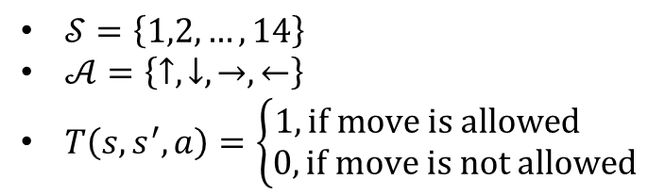
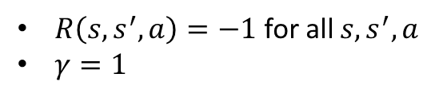


Policy Evaluation
Example : Grid world
 | 1 | 2 | 3
4 | 5 | 6 | 7
8 | 9 | 10 | 11
12 | 13 | 14
$MDP=\{𝒮,𝒜$, $T,R,γ\}$
$𝒮=\left\{1,2,…,14\right\}$
$𝒜=\left\{↑,↓,→,←\right\}$
$T\left(s,s^{′},a\right)=\left\{\begin{aligned}1, if move is allowed \\ 0, if move is not allowed\end{aligned}\right.$
$$T\left(5,6,→\right)=1$$
$$T\left(5,10,→\right)=0$$
$$T\left(7,7,→\right)=1$$
The actions that would take the agent off the grid leave the state unchanged
$R\left(s,s^{′},a\right)=−1$ for all $s,s^{′},a$
$γ=1$
Suppose the agent follows the equiprobable random policy (all actions equality likely),
what is the value function?

Slide 11
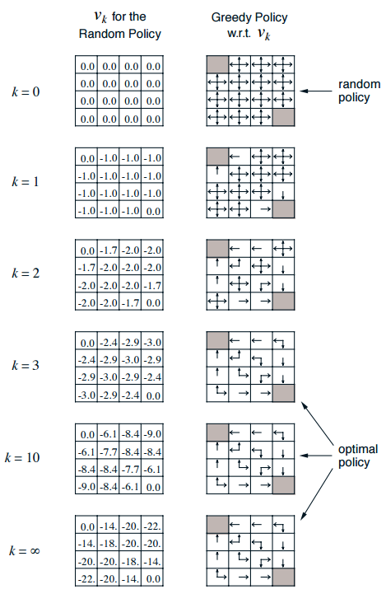
Policy Evaluation

Slide 12





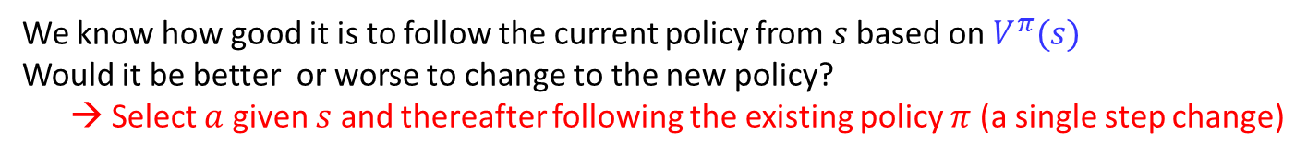

































Policy Improvement
$$Q^{π}(s,a_{1})$$
$$T(s,a_{1},s_{1})$$
$$R\left(s,a_{1},s_{1} \right)$$
$$s_{1}$$
$$V^{π}(s^{′}=s_{1})$$
$$s,a_{1}$$
$$T(s,a_{1}, s_{2})$$
$$s_{2}$$
$$V^{π}(s^{′}=s_{2})$$
$$R\left(s,a_{1},s_{2} \right)$$
$$V^{π}(s)$$
$$Q^{π}(s,a_{2})$$
$$T(s,a_{2},s_{1})$$
$$R\left(s,a_{2},s_{1} \right)$$
$$s_{1}$$
$$V^{π}(s^{′}=s_{1})$$
$$s$$
$$a_{2}=π(s)$$
$$s,a_{2}$$
$$V^{π}\left(s\right)=Q_{ }^{π}\left(s,π(s)\right)$$
$$T(s,a_{2}, s_{2})$$
$$s_{2}$$
$$V^{π}(s^{′}=s_{2})$$
$$R\left(s,a_{2},s_{2} \right)$$
$$Q^{π}(s,a_{3})$$
$$T(s,a_{3},s_{1})$$
$$R\left(s,a_{3},s_{1} \right)$$
$$s_{1}$$
$$V^{π}(s^{′}=s_{1})$$
$$s,a_{3}$$
$$T(s,a_{3}, s_{2})$$
$$s_{2}$$
$$V^{π}(s^{′}=s_{2})$$
$$R\left(s,a_{3},s_{2} \right)$$
We know how good it is to follow the current policy from $s$ based on $V^{π}(s)$
Would it be better or worse to change to the new policy?
→ Select $a$ given $s$ and thereafter following the existing policy $π$ (a single step change)

Slide 13



























Policy Improvement
$$Q^{π}(s,a_{1})$$
$$T(s,a_{1},s_{1})$$
$$R\left(s,a_{1},s_{1} \right)$$
$$s_{1}$$
$$V^{π}(s^{′}=s_{1})$$
$$s,a_{1}$$
$Q_{ }^{π}\left(s,a_{1}\right)$
$$T(s,a_{1}, s_{2})$$
$$s_{2}$$
$$V^{π}(s^{′}=s_{2})$$
$$R\left(s,a_{1},s_{2} \right)$$
$$V^{π}(s)$$
$$Q^{π}(s,a_{2})$$
$$T(s,a_{2},s_{1})$$
$$R\left(s,a_{2},s_{1} \right)$$
$$s_{1}$$
$$V^{π}(s^{′}=s_{1})$$
$$s$$
$$a_{2}=π(s)$$
$$s,a_{2}$$
$$V^{π}\left(s\right)=Q_{ }^{π}\left(s,π(s)\right)$$
$$T(s,a_{2}, s_{2})$$
$$s_{2}$$
$$V^{π}(s^{′}=s_{2})$$
$$R\left(s,a_{2},s_{2} \right)$$
$$Q^{π}(s,a_{3})$$
$$T(s,a_{3},s_{1})$$
$$R\left(s,a_{3},s_{1} \right)$$
$$s_{1}$$
$$V^{π}(s^{′}=s_{1})$$
$$s,a_{3}$$
$$T(s,a_{3}, s_{2})$$
$$s_{2}$$
$$V^{π}(s^{′}=s_{2})$$
$$R\left(s,a_{3},s_{2} \right)$$
$$Q_{ }^{π}\left(s,a_{1}\right)≥V^{π}\left(s\right){=Q}_{ }^{π}\left(s,π(s)\right)?$$

Slide 14












Policy Improvement
$$Q^{π}(s,a_{1})$$
$$T(s,a_{1},s_{1})$$
$$R\left(s,a_{1},s_{1} \right)$$
$$s_{1}$$
$$V^{π}(s^{′}=s_{1})$$
$$s,a_{1}$$
$$T(s,a_{1}, s_{2})$$
$$s_{2}$$
$$V^{π}(s^{′}=s_{2})$$
$$R\left(s,a_{1},s_{2} \right)$$
$$V^{π}(s)$$
$$Q^{π}(s,a_{2})$$
$$T(s,a_{2},s_{1})$$
$$R\left(s,a_{2},s_{1} \right)$$
$$s_{1}$$
$$V^{π}(s^{′}=s_{1})$$
$$s$$
$$a_{2}=π(s)$$
$$s,a_{2}$$
$$V^{π}\left(s\right)=Q_{ }^{π}\left(s,π(s)\right)$$
$$T(s,a_{2}, s_{2})$$
$$s_{2}$$
$$V^{π}(s^{′}=s_{2})$$
$$R\left(s,a_{2},s_{2} \right)$$
$$Q^{π}(s,a_{3})$$
$$T(s,a_{3},s_{1})$$
$$R\left(s,a_{3},s_{1} \right)$$
$$s_{1}$$
$$V^{π}(s^{′}=s_{1})$$
$$s,a_{3}$$
$Q_{ }^{π}\left(s,a_{3}\right)$
$$T(s,a_{3}, s_{2})$$
$$s_{2}$$
$$V^{π}(s^{′}=s_{2})$$
$$R\left(s,a_{3},s_{2} \right)$$
$$Q_{ }^{π}\left(s,a_{3}\right)≥V^{π}\left(s\right){=Q}_{ }^{π}\left(s,π(s)\right)?$$

Slide 15

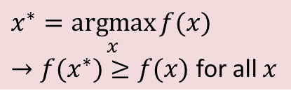

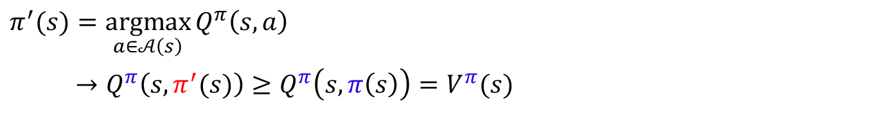
Policy Improvement
$$π^{′}(s)=\underset{a∈𝒜\left(s\right)}{argmax}{Q_{ }^{π}\left(s,a\right)}$$
$→Q_{ }^{π}\left(s,π^{′}(s)\right)≥Q_{ }^{π}\left(s,π\left(s\right)\right)=V^{π}(s)$
$$x^{∗}=\underset{x}{argmax}{f(x)}$$
$→f(x^{∗})≥f(x)$ for all $x$
Improvement criterion =
Expected reward provided by changing one step action and following the original policy
If it is better to select $a=π^{′}\left(s\right)$ once in $s$ and thereafter follow $π$ than it would be to follow $π$ all the time,
?
It is better still to select $a=π^{′}\left(s\right)$ whenever $s$ is encountered
(The new policy $π^{′}\left(s\right)$ is a better policy overall)

Slide 16
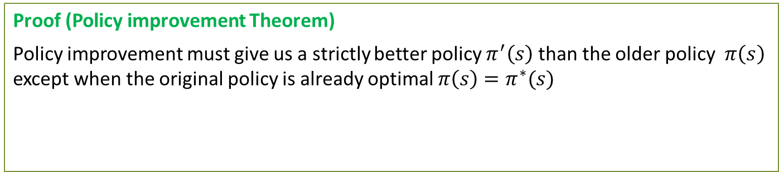

Policy Improvement
$$π^{′}(s)=\underset{a∈𝒜\left(s\right)}{argmax}{Q_{ }^{π}\left(s,a\right)}$$
$→Q_{ }^{π}\left(s,π^{′}(s)\right)≥Q_{ }^{π}\left(s,π\left(s\right)\right)=V^{π}(s)$
$$x^{∗}=\underset{x}{argmax}{f(x)}$$
$→f(x^{∗})≥f(x)$ for all $x$
Improvement criterion =
Expected reward provided by changing one step action and following the original policy
Proof (Policy improvement Theorem)
Policy improvement must give us a strictly better policy $π^{′}\left(s\right)$ than the older policy $π\left(s\right)$ except when the original policy is already optimal $π\left(s\right)=π^{∗}(s)$
$Q^{π}\left(s,π^{′}\left(s\right)\right)≥V^{π}\left(s\right) →{ V}^{π^{′}}\left(s\right)≥V^{π}(s)$ for all states $s∈𝒮$
$$π^{′}≥π$$

Slide 17

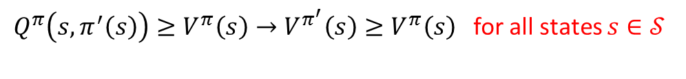
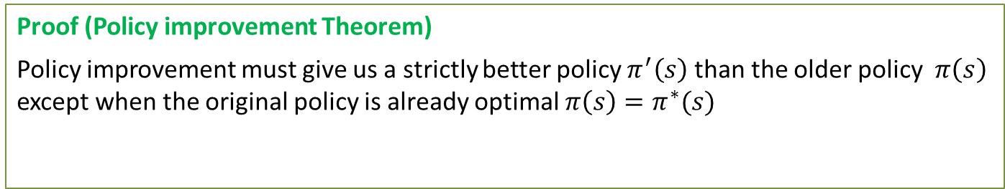

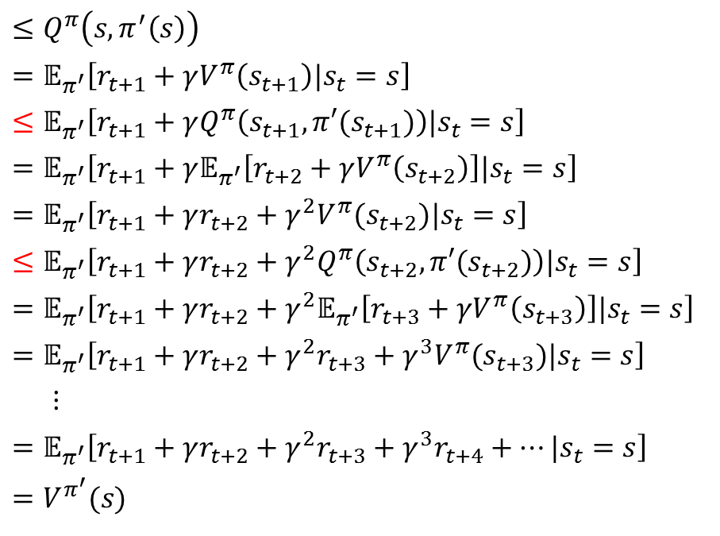

Policy Improvement
Proof (Policy improvement Theorem)
Policy improvement must give us a strictly better policy $π^{′}\left(s\right)$ than the older policy $π\left(s\right)$ except when the original policy is already optimal $π\left(s\right)=π^{∗}(s)$
$Q^{π}\left(s,π^{′}\left(s\right)\right)≥V^{π}\left(s\right)→V^{π^{′}}\left(s\right)≥V^{π}\left(s\right)$for all states $s∈𝒮$
$$V^{π}(s)$$
$$≤Q^{π}\left(s,π^{′}\left(s\right)\right)$$
$$=𝔼_{π^{′}}\left[r_{t+1}+γV^{π}\left(s_{t+1}\right)|s_{t}=s\right]$$
$$≤𝔼_{π^{′}}\left[r_{t+1}+γQ^{π}\left(s_{t+1},π′(s_{t+1})\right)|s_{t}=s\right]$$
$$=𝔼_{π^{′}}\left[r_{t+1}+γ𝔼_{π^{′}}\left[r_{t+2}+γV^{π}\left(s_{t+2}\right)\right]|s_{t}=s\right]$$
$$=𝔼_{π^{′}}\left[r_{t+1}+γr_{t+2}+γ^{2}V^{π}(s_{t+2})|s_{t}=s\right]$$
$$≤𝔼_{π^{′}}\left[r_{t+1}+γr_{t+2}+γ^{2}Q^{π}\left(s_{t+2},π′(s_{t+2})\right)|s_{t}=s\right]$$
$$=𝔼_{π^{′}}\left[r_{t+1}+γr_{t+2}+γ^{2}𝔼_{π^{′}}\left[r_{t+3}+γV^{π}\left(s_{t+3}\right)\right]|s_{t}=s\right]$$
$$=𝔼_{π^{′}}\left[r_{t+1}+γr_{t+2}+γ^{2}r_{t+3}+γ^{3}V^{π}(s_{t+3})|s_{t}=s\right]$$
$$⋮$$
$$=𝔼_{π^{′}}\left[r_{t+1}+γr_{t+2}+γ^{2}r_{t+3}+γ^{3}r_{t+4}+…|s_{t}=s\right]$$
$$=V^{π^{′}}(s)$$
Given
$𝔼_{π^{′}}$ is expectation over $s_{t+1}$ induced by $π^{′}$
$${∵V}^{π}\left(s_{t+1}\right) ≤Q^{π}\left(s_{t+1},π^{′}\left(s_{t+1}\right)\right)$$
Thus, $π≤π′$

Slide 18
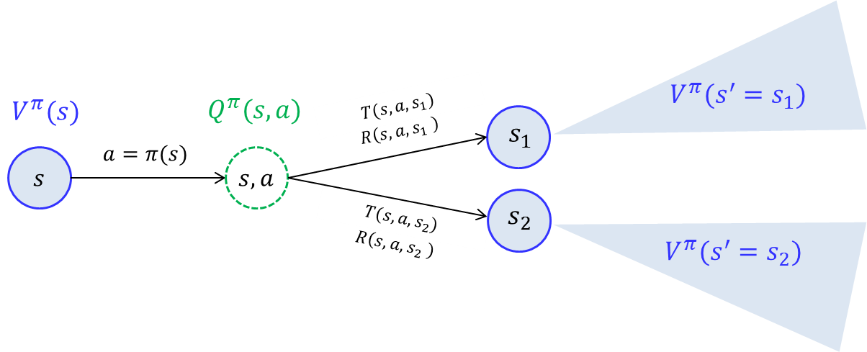
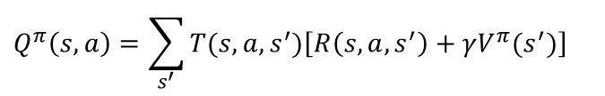
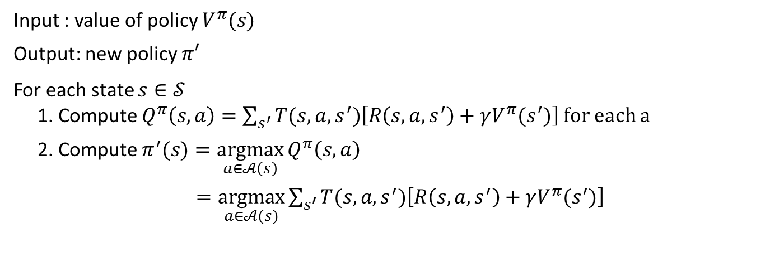
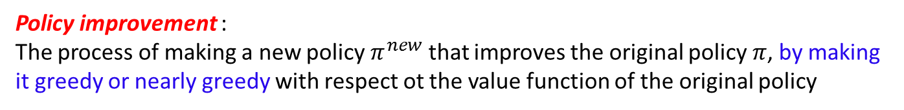
Policy Improvement
Policy improvement :
The process of making a new policy $π^{new}$ that improves the original policy $π$, by making it greedy or nearly greedy with respect ot the value function of the original policy
Recall:
$$Q_{ }^{π}\left(s,a\right)=\sum_{s^{′}}{T(s,a,s^{′})\left[R\left(s,a,s^{′}\right)+γV^{π}(s^{′})\right]}$$
Algorithm
Input : value of policy $V^{π}(s)$
Output: new policy $π′$
For each state $s∈𝒮$
1. Compute $Q_{ }^{π}\left(s,a\right)=\sum_{s^{′}}{T(s,a,s^{′})\left[R\left(s,a,s^{′}\right)+γV^{π}(s^{′})\right]}$ for each a
2. Compute $π^{′}(s)=\underset{a∈𝒜\left(s\right)}{argmax}{Q_{ }^{π}\left(s,a\right)}$
$=\underset{a∈𝒜(s)}{argmax}{\sum_{s^{′}}{T(s,a,s^{′})\left[R\left(s,a,s^{′}\right)+γV^{π}(s^{′})\right]}}$

Slide 19



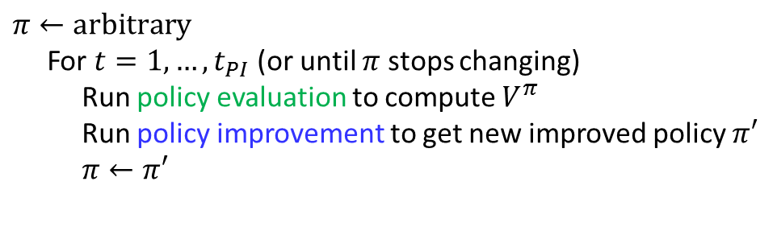



Policy Iteration
Policy iteration :
Iterative way of finding the optimum policy through sequence of policy evaluation and policy improvement
PE
$$V^{π_{0}}$$
PI
PE
$$V^{π_{1}}$$
PI
PE
$$V^{π_{2}}$$
PI
$$π_{0}$$
$$π_{1}$$
$$π_{2}$$
Algorithm
$$π←arbitrary$$
For $t=1,…,t_{PI}$ (or until $π$ stops changing)
Run policy evaluation to compute $V^{π}$
Run policy improvement to get new improved policy $π′$
$π←π′$
Policy evaluation require iterative computation, requiring multiple sweeps through the state set
policy evaluation starts with the value function for the previous policy
→ Fast convergence

Slide 20


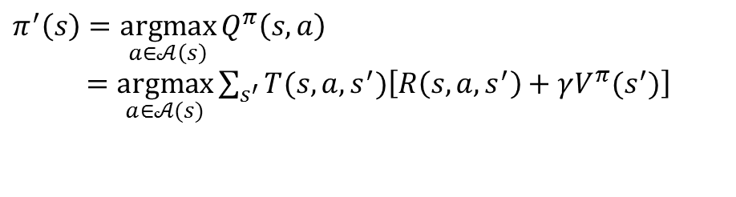


Policy Iteration
Policy iteration :
Iterative way of finding the optimum policy through sequence of policy evaluation and policy improvement
For $t=0,…$until convergence
For each state $s$:
Iteration
$$V_{t+1}^{π}(s)←\sum_{s′}{T(s,π(s),s^{′})\left\{R\left(s,π(s),s^{′}\right)+γV_{t}^{π}(s′)\right\}}$$
Converged state value function $V^{π}(s)$
For each state $s$:
$$π^{′}\left(s\right)=\underset{a∈𝒜\left(s\right)}{argmax}{Q_{ }^{π}\left(s,a\right)}$$
$=\underset{a∈𝒜(s)}{argmax}{\sum_{s^{′}}{T(s,a,s^{′})\left[R\left(s,a,s^{′}\right)+γV^{π}(s^{′})\right]}}$

Slide 21


Policy Iteration
$$V^{π}(s)$$
$$π^{′}\left(s\right)$$

Slide 22
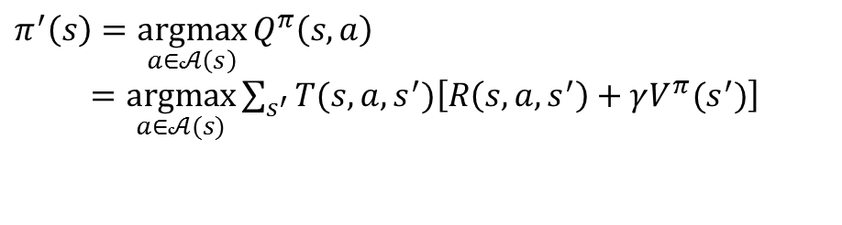
Policy Iteration
Policy iteration :
Iterative way of finding the optimum policy through sequence of policy evaluation and policy improvement
For $t=0,…$until convergence
For each state $s$:
Iteration
$$V_{t+1}^{π}(s)←\sum_{s′}{T(s,π(s),s^{′})\left\{R\left(s,π(s),s^{′}\right)+γV_{t}^{π}(s′)\right\}}$$
Converged state value function $V^{π}(s)$
For each state $s$:
$$π^{′}\left(s\right)=\underset{a∈𝒜\left(s\right)}{argmax}{Q_{ }^{π}\left(s,a\right)}$$
$=\underset{a∈𝒜(s)}{argmax}{\sum_{s^{′}}{T(s,a,s^{′})\left[R\left(s,a,s^{′}\right)+γV^{π}(s^{′})\right]}}$
Issues :
Policy evaluation requires iterative computation, requiring multiple sweeps
through the state set → slow to converge

Slide 23
Policy Iteration

Slide 24



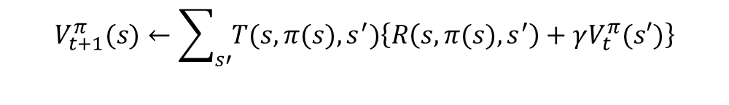

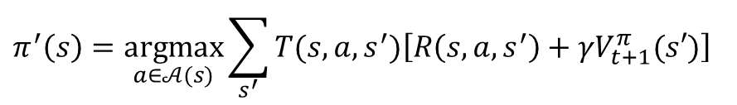
Value Iteration
Solution:
Stop policy evaluation after just one sweep (one backup of each state)
Combine one sweep of policy evaluation and one sweep of policy improvement
For each state $s$:
$$V_{t+1}^{π}(s)←\sum_{s′}{T(s,π(s),s^{′})\left\{R\left(s,π(s),s^{′}\right)+γV_{t}^{π}(s′)\right\}}$$
+
For each state $s$:
$$π^{′}\left(s\right)=\underset{a∈𝒜(s)}{argmax}{\sum_{s^{′}}{T(s,a,s^{′})\left[R\left(s,a,s^{′}\right)+γV_{t+1}^{π}(s′)\right]}}$$
→
For each state $s$:
Value Iteration
$$V_{t+1}(s)←\max_{a∈𝒜(s)}{\sum_{s′}{T(s,a,s^{′})\left\{R\left(s,a,s^{′}\right)+γV_{t}(s)\right\}}}$$
or, can be obtained simply by turning the Bellman optimality equation into an update rule :
$$V^{∗}\left(s\right)=\max_{a∈𝒜(s)}{\sum_{s′}{T(s,a,s^{′})\left\{R\left(s,a,s^{′}\right)+γV^{∗}\left(s′\right)\right\}}}$$

Slide 25
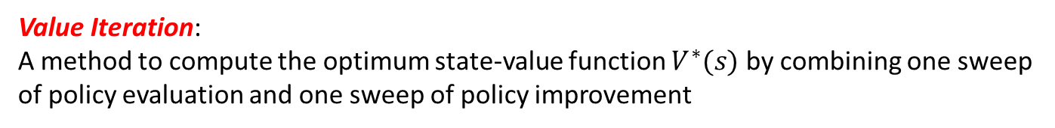

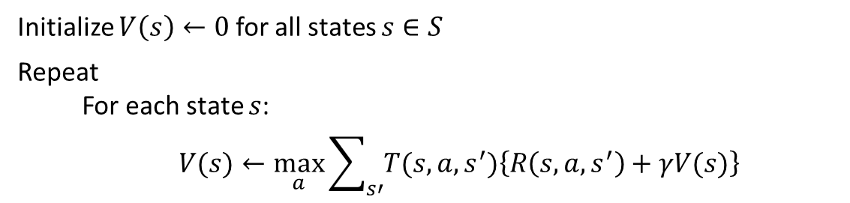
Value Iteration
Value Iteration:
A method to compute the optimum state-value function $V^{∗}(s)$ by combining one sweep of policy evaluation and one sweep of policy improvement
Algorithm
Initialize $V\left(s\right)←0$ for all states $s∈S$
Repeat
For each state $s$:
$$V(s)←\max_{a}{\sum_{s′}{T(s,a,s^{′})\left\{R\left(s,a,s^{′}\right)+γV(s)\right\}}}$$
Until $\max_{s∈S}\left|V_{t}\left(s\right)−V_{t−1} (s)\right|≤e$
Optimum policy can be obtained from the converged $V^{∗}(s)$:
$$π^{∗}\left(s\right)=\underset{a∈𝒜(s)}{argmax}{\sum_{s′}{T(s,a, s^{′})\left\{R\left(s,a,s^{′}\right)+γV^{∗}\left(s\right)\right\}}}$$

Slide 26
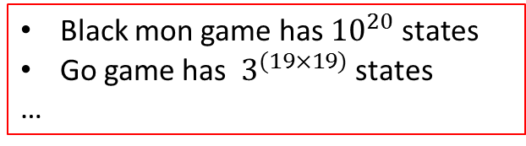










Asynchronous DP Algorithms
A major drawback to the DP methods is that they involve operations over the entire state set of the MDP
$$V^{π}\left(s\right)$$
$$V^{π}\left(s\right)$$
$$s_{1}$$
Black mon game has ${10}^{20}$ states
Go game has $3^{(19×19)}$ states
…
$$s_{1}$$
$$s_{2}$$
$$s_{2}$$
$$s_{3}$$
$$s_{3}$$
sweep
Take forever to sweep all states
Does not improve policy until value functions are full backed up
$$s_{N}$$
$$s_{N}$$
Conventional DP Algorithms
Asynchronous DP Algorithms
Back up the values of states in any order whatsoever, using whatever values of other states happen to be available
Allow great flexibility in selecting states to which backup operations are applied
Make it easier to intermix computation with real-time interaction: To solve a given MDP, we can run iterative DP algorithm at the same time that an agent is actually experiencing the MDP (Reinforcement Learning !!!!)

Slide 27
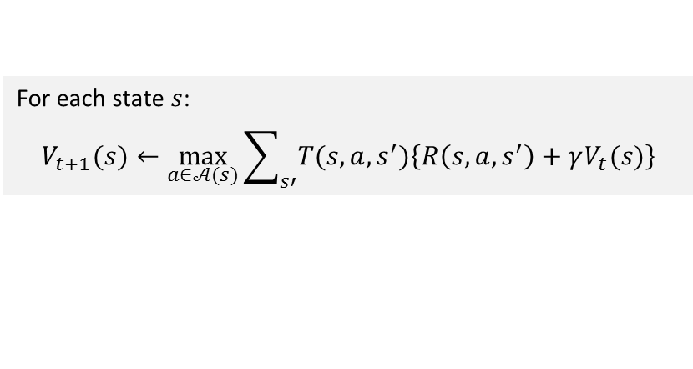
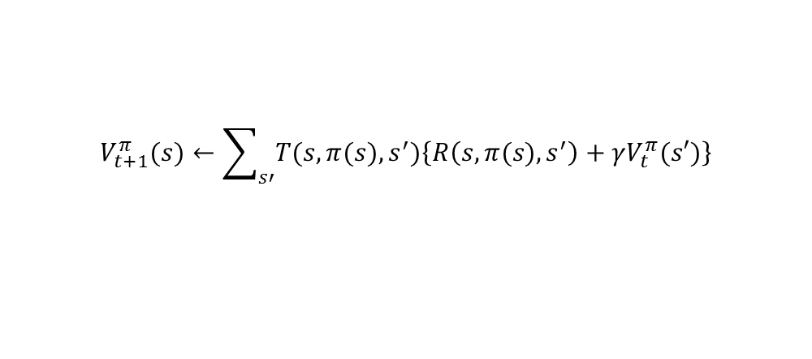


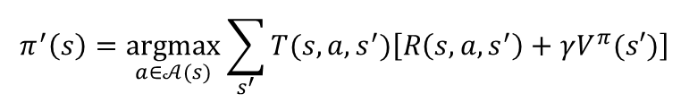

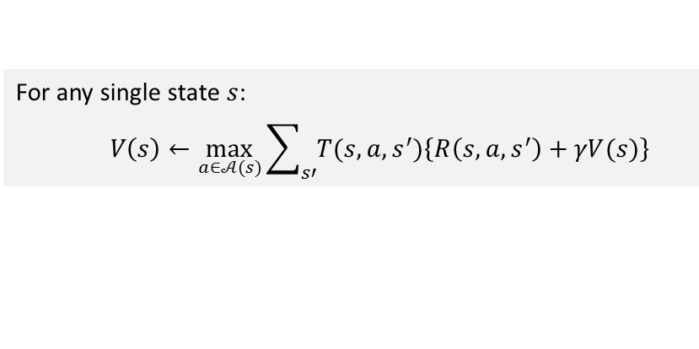
Value Iteration
Policy Evaluation
For $t=1,…$
For each state $s$:
$$V_{t+1}^{π}(s)←\sum_{s′}{T(s,π(s),s^{′})\left\{R\left(s,π(s),s^{′}\right)+γV_{t}^{π}(s′)\right\}}$$
Policy Iteration
Policy Improvement
For each state $s$:
$$π^{′}\left(s\right)=\underset{a∈𝒜(s)}{argmax}{\sum_{s^{′}}{T(s,a,s^{′})\left[R\left(s,a,s^{′}\right)+γV^{π}(s′)\right]}}$$
Value Iteration
For each state $s$:
$$V_{t+1}(s)←\max_{a∈𝒜(s)}{\sum_{s′}{T(s,a,s^{′})\left\{R\left(s,a,s^{′}\right)+γV_{t}(s)\right\}}}$$
Asynchronous Value iteration
For any single state $s$:
$$V\left(s\right)←\max_{a∈𝒜(s)}{\sum_{s′}{T(s,a,s^{′})\left\{R\left(s,a,s^{′}\right)+γV(s)\right\}}}$$
As long as both processes continue to update all states, the ultimate result is typically the same-convergence to the optimal value function and an optimal policy

Slide 28

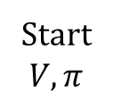


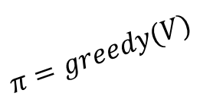
Generalized Policy Iteration
Generalized Policy Iteration :
an general idea of interaction between policy evaluation and policy improvement processes
$$V=V^{π}$$
Solution of policy evaluation
Stabilized
(solution of Bellman optimality equation)
$$V^{∗}$$
Start
$$V, π$$
$$π^{∗}$$
Solution of policy improvement
$$π=greedy(V)$$
Making policy greedy with respect to the value function typically makes the value function incorrect for the changed policy
Making the value function consistent with the policy typically causes that policy no longer to be greedy
In the long run, however, these two processes interact to find a single joint solution:
the optimal value function and optimal policy

Slide 29


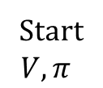
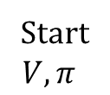




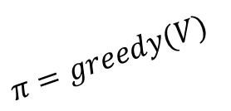
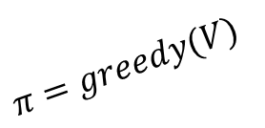
Generalized Policy Iteration
Generalized Policy Improvement (GPI)
Dynamic Programming
“full backup”
Asynchronous
Dynamic Programming
$$V=V^{π}$$
$$V=V^{π}$$
Solution of policy evaluation
Solution of policy evaluation
$$V^{∗}$$
$$V^{∗}$$
Start
$$V, π$$
$$π^{∗}$$
Start
$$V, π$$
$$π^{∗}$$
Solution of policy improvement
Solution of policy improvement
$$π=greedy(V)$$
$$π=greedy(V)$$
Asynchronous Dynamic Programming is a core concept in Reinforcement learning

Slide 30


Efficiency of Dynamic Programming
$n$ : Number of states
$m$ : Number of actions
A DP method is guaranteed to find an optimal policy in polynomial time even though the total number of deterministic policies is $m^{n}$
Linear programming methods can also be used to solve MDPs, and in some case their worst-case convergence are better than those of DP methods. But linear programming methods become impractical at a much smaller number of states than do DP methods
A DP method is guaranteed to find an optimal
For a large problem, asynchronous DP is more efficient
DP methods update estimates of the values of states based on estimates of the values of successor sates→ update is based on other update (bootstrapping)

